Slide 1
Forking Workflow
By Carlo DiLorenzo

Slide 2
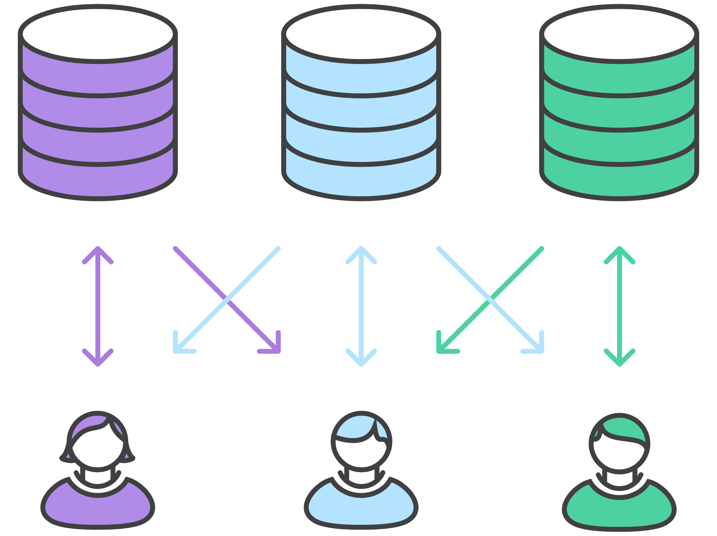
Two Git Tepositories
Private local one and a public server-side one.
Private
Public
Private

Slide 3
Advantages of Forking Workflow
Developers push to their own server-side repositories.
This allows project maintainer be the filter to the official codebase.
This is ideal workflow for open source projects.

Slide 4
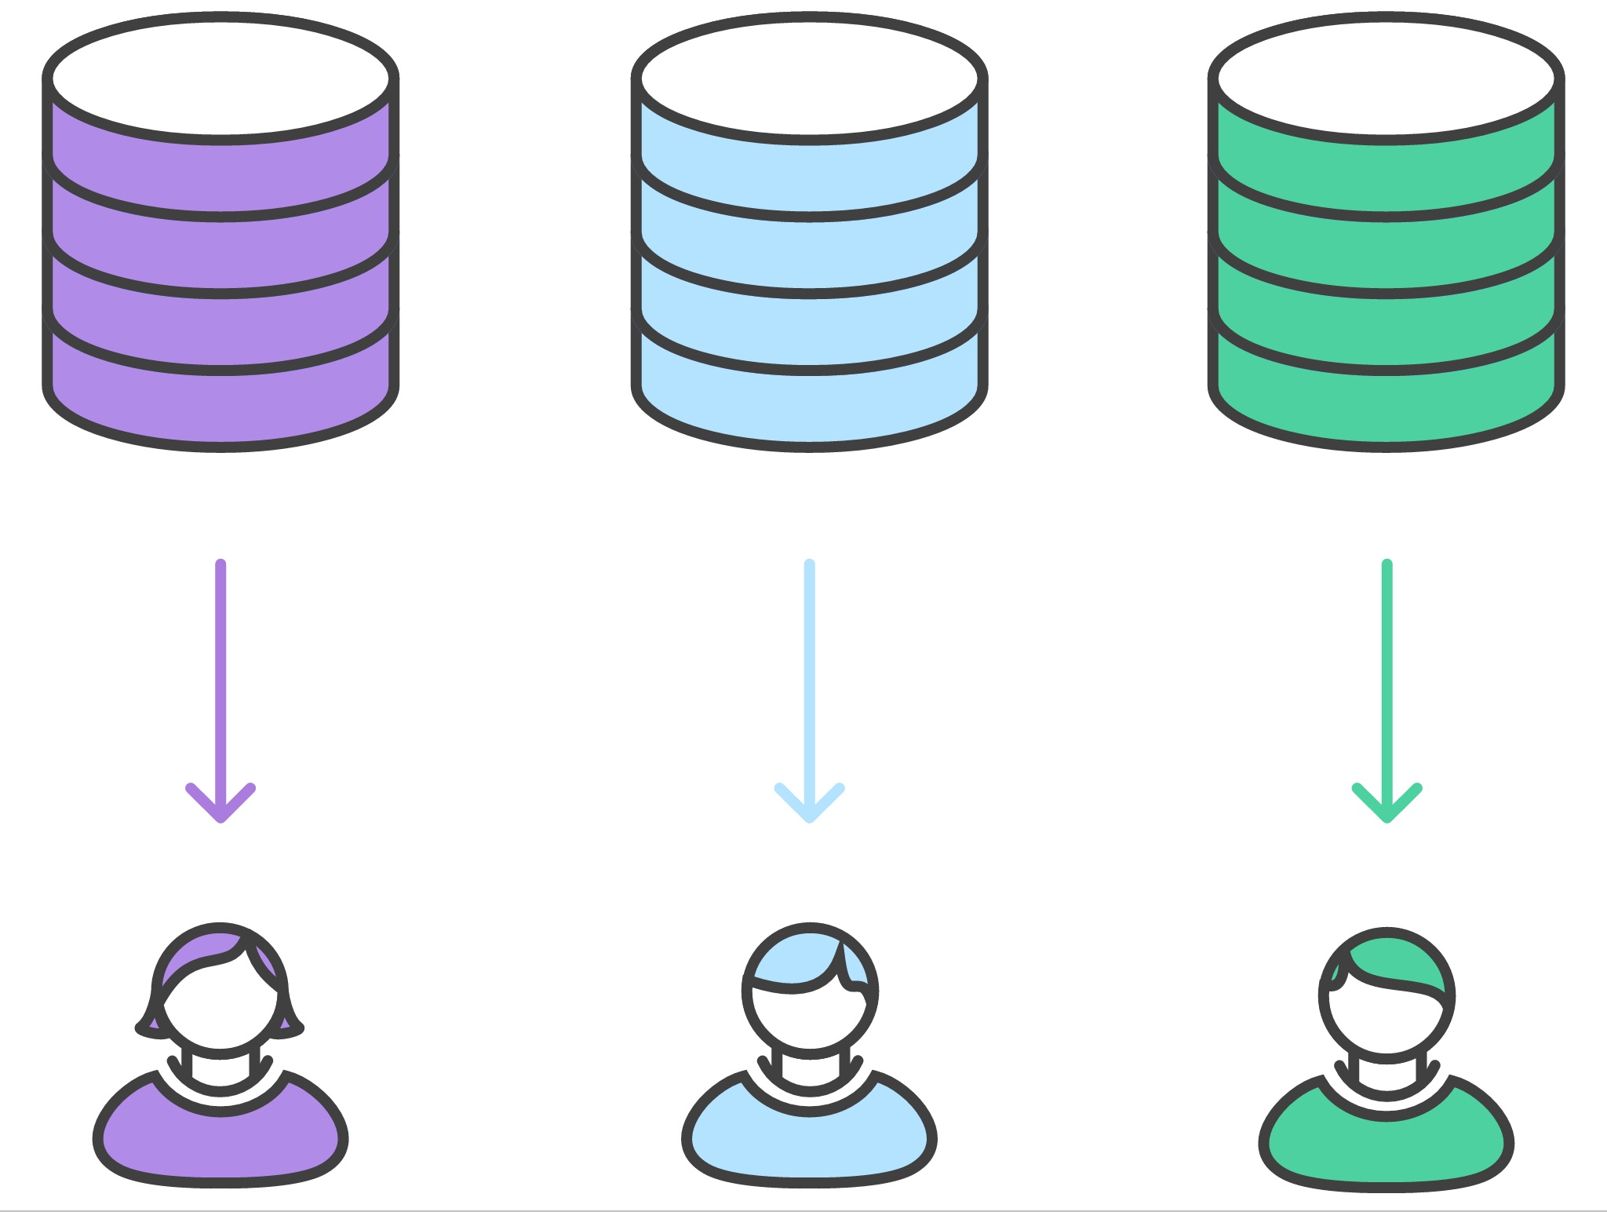
Clone from forked repositories
Clone from you own forked repositories.

Slide 5
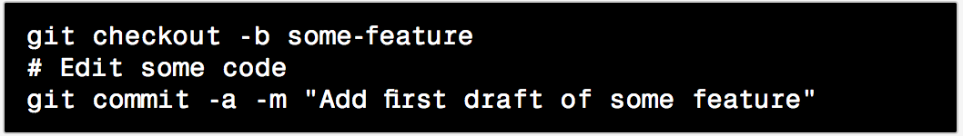
Developers work on their features
In local repositories that was just cloned, developers can edit code, commit changes, and create branches
When project has moved forward, to update new commits do command

Slide 6
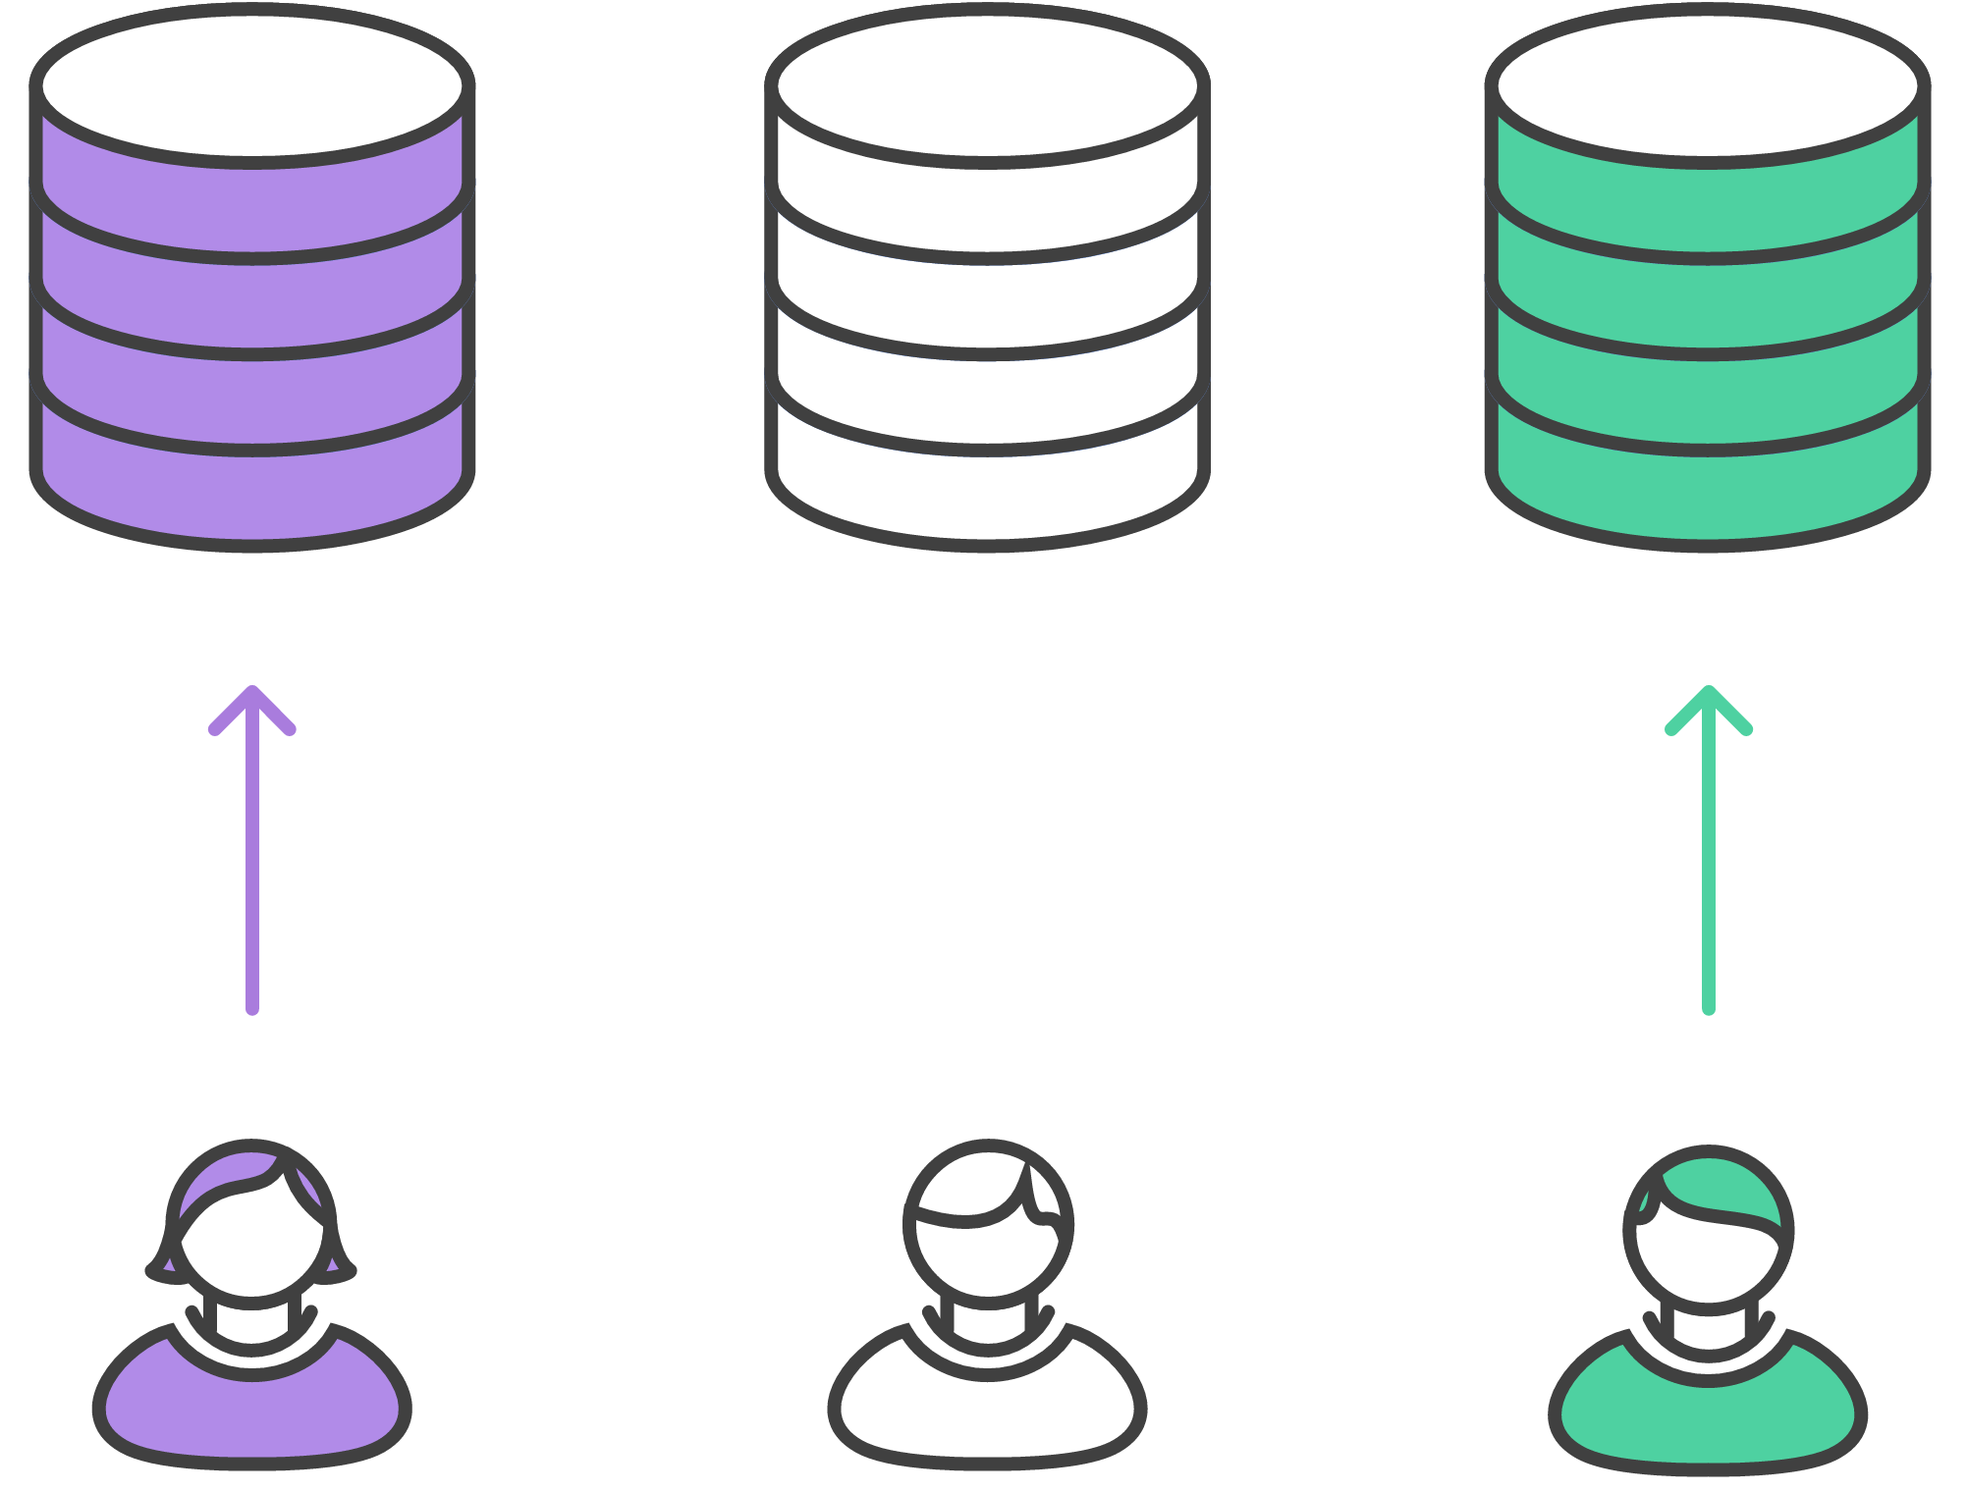
Publish a feature
Push to the public repository.

Slide 7
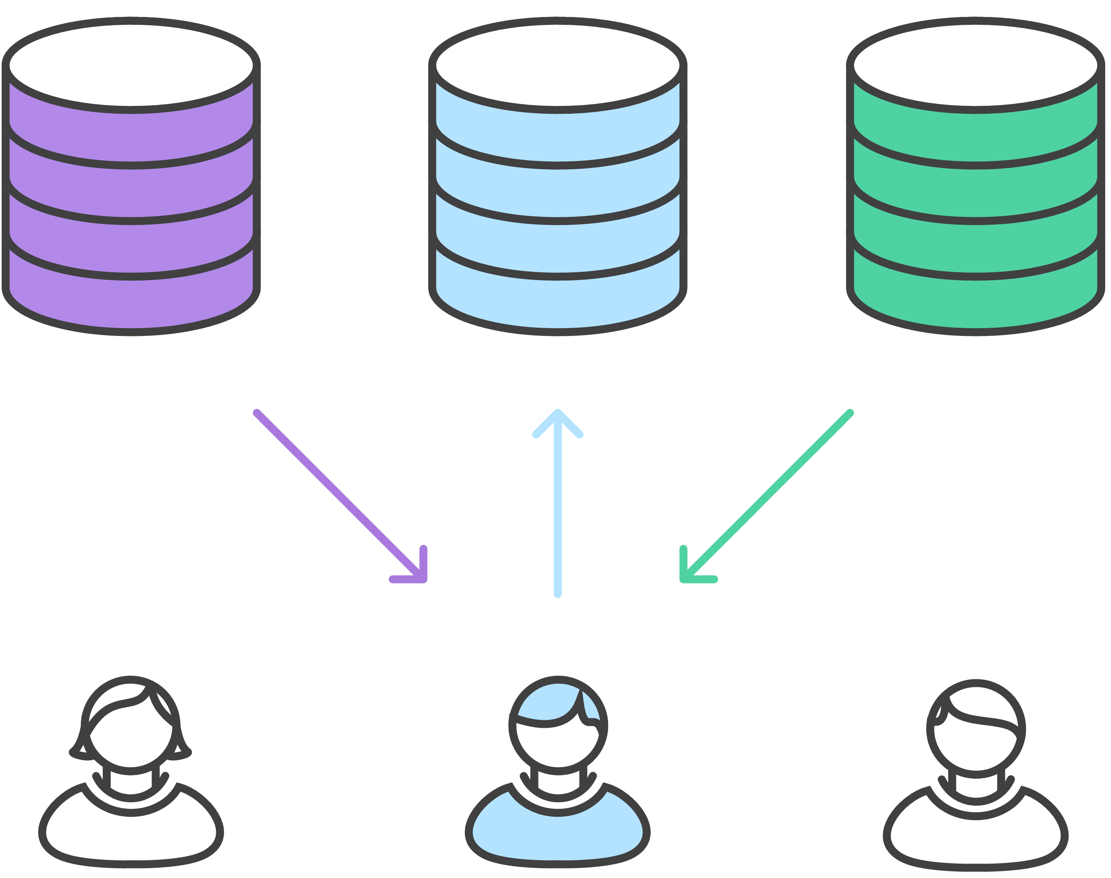
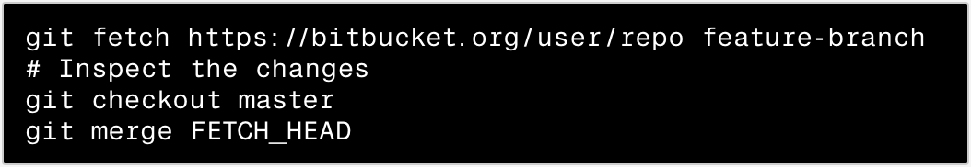
Project Maintainer Integrates
Fetch and integrate to master repo

Slide 8
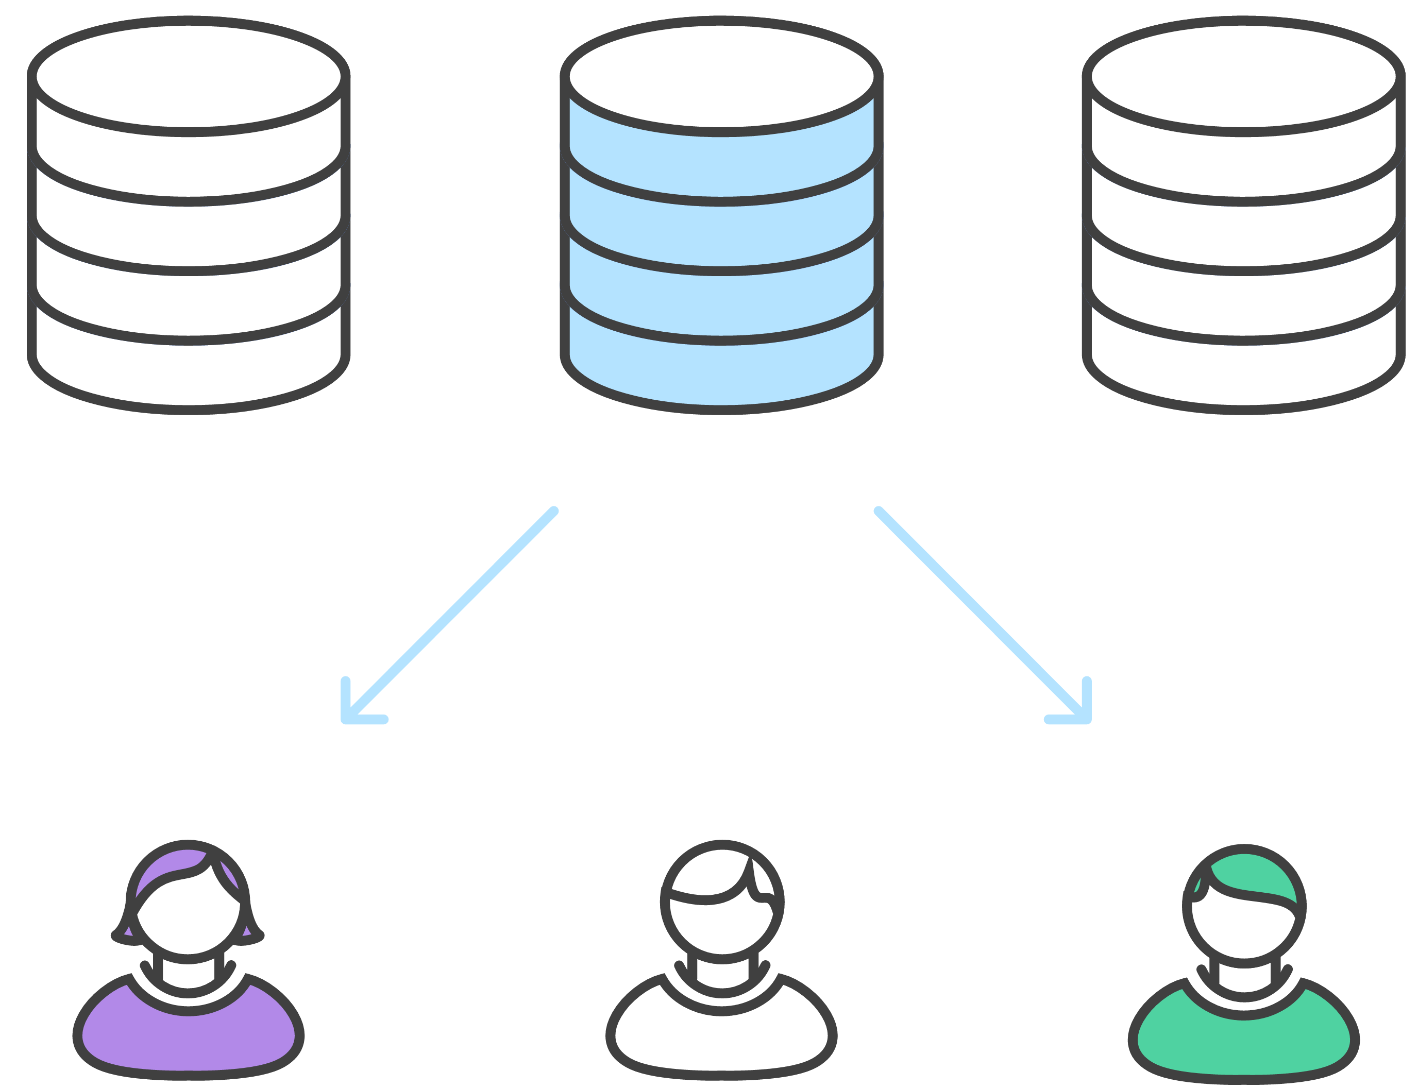
Developers synchronize with official repo
Synchronize to changes with main codebase master

